Slide 1
Matrix Factorization

Slide 2
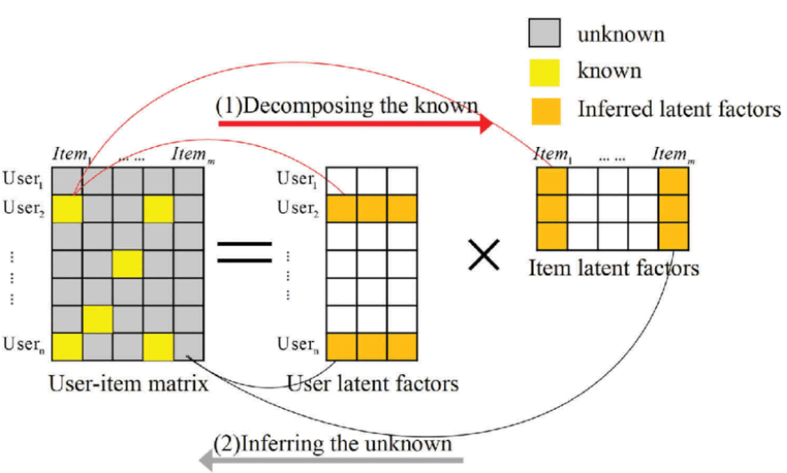
What is Matrix Factorization
S
X
L

Slide 3
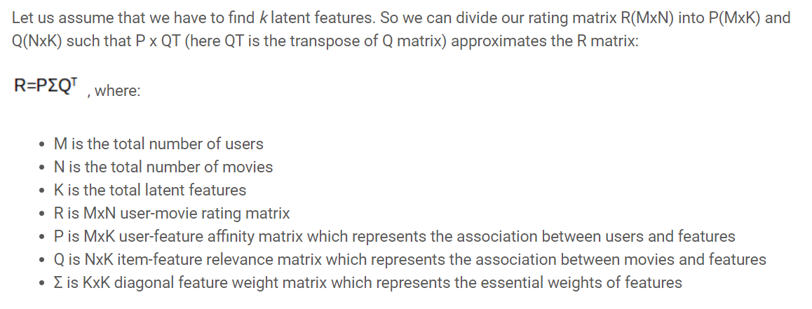
What is Matrix Factorization
S
X
L

Slide 4
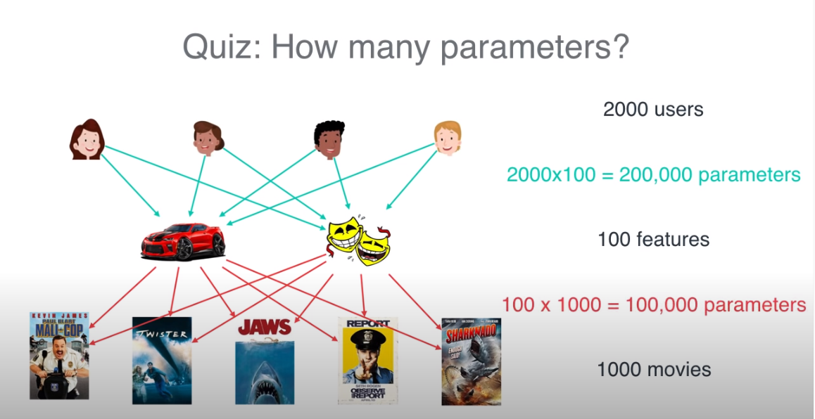
Why Matrix Factorization

Slide 5
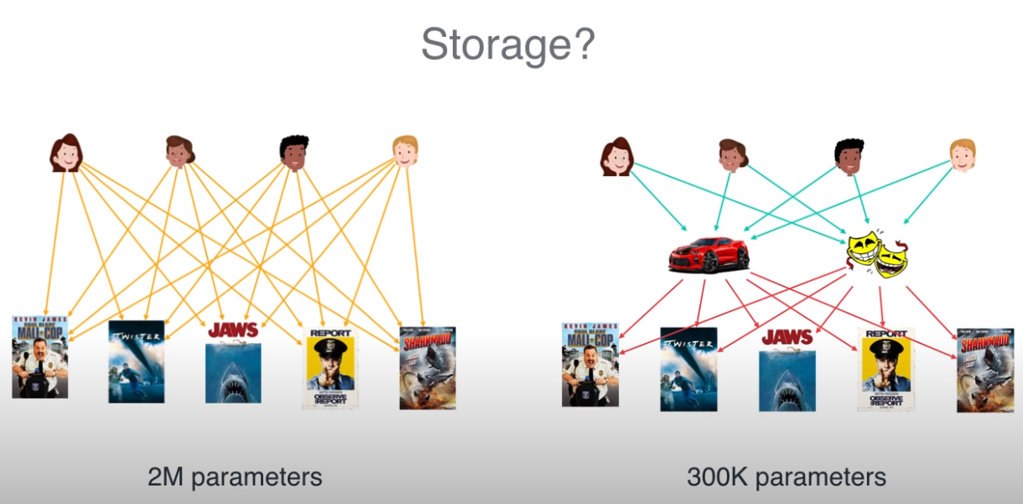
Why Matrix Factorization

Slide 6
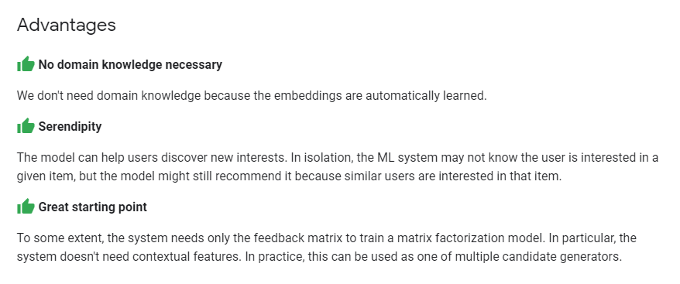
Why Matrix Factorization

Slide 7
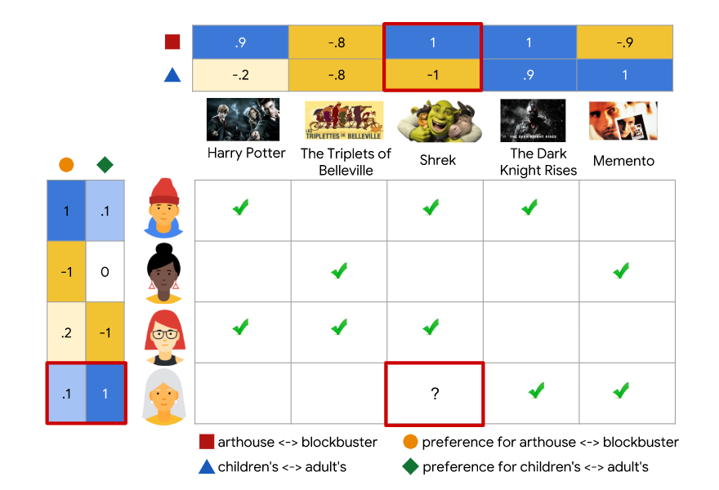
How to do Matrix Factorization

Slide 8

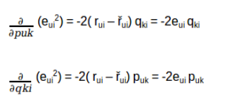
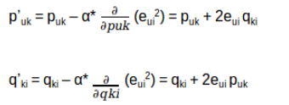
How to do Matrix Factorization

Slide 9
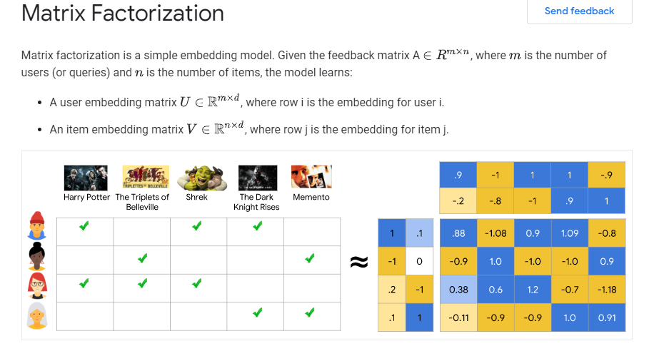
How to do Matrix Factorization

